Slide 1
N5 Computing Science
Notes:
Python functions: https://docs.python.org/3/library/functions.html

Slide 2
Plan – N5 Year 1
SDD
Software Design and Development (40%)
DDD
Database Design and Development (25%)
WDD
Web Design and Development (25%)
Computer Systems (10%)
C/Sys
Notes:
Hide as appropriate

Slide 3
Implementation
Python

Slide 4
Thonny
thonny.org

Slide 5
Sharepoint

Slide 6
Learning Intentions
Describe and use internal commentary

Slide 7
Internal Commentary
Use internal commentary in all programs
As a minimum:
  1 # Title: My First Program
  2 # Author: Mr Friend
  3 # Date: 27 September 2026
Ignored by computer
Hash symbol (comment)
Line numbers
Notes:
Helps to tell the 'story' of what the program does

Slide 8
Internal Commentary
Start all programs with internal commentary
As a minimum:
  1 # Title:
  2 # Author:
  3 # Date:

Slide 9
Learning Intentions
Describe and use output to the screen

Slide 10
Display information
1 # Display text
2 print("Hello world")
3
4 # Display a number
5 print(3.14)
Text to be displayed
Number to be displayed

Slide 11
Display information
1 # Display text
2 print("Hello world")
3
4 # Display a number
5 print(3.14)
Notes:
After this, internal commentary omitted from slides to save space

Slide 12
Learning Intentions
Describe and identify syntax errors

Slide 13
Syntax Errors
Program will not run until all syntax errors corrected
1 # Display some text
2 print(Hello world")
3
4 # Display a number
5 print(3.14)
Opening quotation mark missing
Unexpected indentation (extra spaces)
Notes:
Often, the line number of the error is where it is spotted not where it is.

Slide 14
Syntax Errors
1 # Display some text
2 print(Hello world")
3
4 # Display a number
5 print(3.14)
Notes:
Often, the line number of the error is where it is spotted not where it is.

Slide 15
Learning Intentions
Describe and use data types

Slide 16
Data type – Character
A single character
A letter – "a", "z", "G"
A number – "0", "7"
A symbol – "!", ";", "@"
All with quotation marks
Notes:
Python also allows single quotation marks: 'abcXYZ'

Slide 17
Data type – Character
A letter – "a", "z", "G"
A number – "0", "7"
A symbol – "!", ";", "@"

Slide 18
Data type – String
A string of characters
Letters – "abcXYZ"
Numbers – "123890"
Symbols – "!£$*()"
Mixture – "Hello 2 u !!!!"
All with quotation marks
Notes:
Python also allows single quotation marks: 'abcXYZ'

Slide 19
Data type – String
Letters – "abcXYZ"
Numbers – "123890"
Symbols – "!£$*()"
Mixture – "Hello 2 u !!!!"

Slide 20
Data type – Integer
Whole numbers
Positive and negative
–9999
0
3

Slide 21
Data type – Integer
–9999
0
3

Slide 22
Data type – Real
Decimal numbers
Positive and negative
–99·999
0·0
3·14
Also known as ‘Floating point’

Slide 23
Data type – Real
–99·999
0·0
3·14

Slide 24
Data type – Boolean
Binary choice
True or False
Can be used to represent:
  Yes / No
  On / Off
  1 / 0

Slide 25
Data type – Boolean
Can be used to represent:

Slide 26
Data types
Type | Description | Examples
Character | A single character | "a", "1", "@"
String | A string of characters | "Hello", "01871"
Integer | Whole numbers | 3, -99, 0
Real | Decimal numbers | 3·14, -99·6, 0·0
Boolean | Binary – two states | True / False

Slide 27
Data types
Type | Description | Examples
 |  | "a", "1", "@"
 |  | "Hello", "01871"
 |  | 3, -99, 0
 |  | 3·14, -99·6, 0·0
 |  | True / False

Slide 28
Learning Intentions
Assign values in a program

Slide 29

What is a variable?
Somewhere to store information
Has a name
Can be thought of as a box
Can only store 1 piece of info

Slide 30

How do they work?
Store 11 in variable1
Copy variable1 to variable2
Variable created, with a name
Value stored in it
11
11
variable1
variable2

Slide 31
What is it?
=
Maths: equals sign
This is computing, not maths!
(is the same as)
Computing: assignment operator
(is assigned the value )

Slide 32
What is it?
=
Maths:
Computing:

Slide 33
Assignment – variable
Value assigned
to variable
Variable name
Value to be stored
age = 18
Assignment operator
Notes:
A single value.

Slide 34
Assignment – variable
age = 18

Slide 35
Spot the Variables
String
name
"name"
"date"
date
length
"length"
Variable
weight
"weight"
height
"height"
Strings have quotation marks, variables do not!
Notes:
Class: Markup strings with ink

Slide 36
Spot the Variables
name
"name"
"date"
date
length
"length"
weight
"weight"
height
"height"

Slide 37
Spot the Numbers
Number
"999"
999
3.14
"3.14"
-0.03
"-0.03"
String
17.5
"17.5"
"42"
42
Strings have quotation marks, numbers do not!
Notes:
Class: Markup strings with ink

Slide 38
Spot the Numbers
"999"
999
3.14
"3.14"
-0.03
"-0.03"
17.5
"17.5"
"42"
42

Slide 39
Trace table
word1 | word2
1 word1 = "Hello"
2 word2 = "world"
3 word1 = "What?"
4 word1 = "Bye"
5 word2 = "all!"
"Hello"
"world"
"What?"
"Bye"
"all!"
Notes:
Not part of N5 but useful for clearing up misconceptions about variables
When a variable is overwritten there is no history of the previous value – obliterated!

Slide 40
Trace Table
word1 | word2
1 word1 = "Hello"
2 word2 = "world"
3 word1 = "What?"
4 word1 = "Bye"
5 word2 = "all!"

Slide 41
Display Variables
1 text = "Hello world"
2 print(text)
3
4 age = 17
5 print(age)
Variable name
Variable name

Slide 42
Display Variables
1 text = "Hello world"
2 print(text)
3
4 age = 17
5 print(age)

Slide 43
Learning Intentions
Describe and use meaningful identifiers

Slide 44
Variable names – Rules
Start with a letter
Only contain letters, numbers, underscores
No spaces
Unique
Examples
  height cost
  age number_2 number1

Slide 45
Variable names – Rules
Examples

Slide 46
Variable names – Conventions
Mixed case
Meaningful
Singular (not plural)
Examples
  pupilAge costPerKilo kgs2lbs
  petName examGrade
Notes:
Mixed case – lower case with humps, not CamelCase
Use singular for variable names
Uppercase letters used for constants: PI = 3·14

Slide 47
Variable names – Conventions
Examples

Slide 48
Learning Intentions
Describe and use arithmetic operations

Slide 49
Arithmetic Operators
Problem
Result
+ Add
– Subtract
* Multiply
/ Divide
** Power of
3 + 7 = 10
9 – 4 = 5
2 * 3 = 6
8 / 4 = 2.0
3 ** 2 = 9
Division always gives a real value
Notes:
Python division always results in a real value

Slide 50
Arithmetic Operators
Problem
Result
Add
Subtract
Multiply
Divide
Power of
3 =
9 =
2 =
8 =
3 =

Slide 51
Learning Intentions
Describe and identify execution errors

Slide 52
Execution Errors
Program will run but then stop (crash)
1 print("This works!")
2
3 age = 17
4 print(age / 0)
5
6 number = "2"
7 print(number + 2)
Division by zero
Incompatible data types
String
Integer

Slide 53
Execution Errors
1 print("This works!")
2
3 age = 17
4 print(age / 0)
5
6 number = "2"
7 print(number + 2)

Slide 54
Learning Intentions
Assign values in a program
Notes:
Doing it better!

Slide 55
Type Hinting
Data type
1 name: str = ""
2 age: int = 0
3
4 name = "Bob"
5 age = 15
6
7 print(name)
8 print(age)
Initial value
Initialise variables to the correct data type!

Slide 56
Type Hinting
1 name: str = ""
2 age: int = 0
3
4 name = "Bob"
5 age = 15
6
7 print(name)
8 print(age)

Slide 57
Type Hinting
N5 CS
Python
Character
String
Integer
Real
Boolean
Array of characters
Array of real
str
str
int
float
bool
list[str]
list[float]
Notes:
https://docs.python.org/3/library/typing.html

Slide 58
Type Hinting
N5 CS
Python
Character
String
Integer
Real
Boolean
Array of characters
Array of real

Slide 59
Learning Intentions
Describe and use the predefined functions

Slide 60
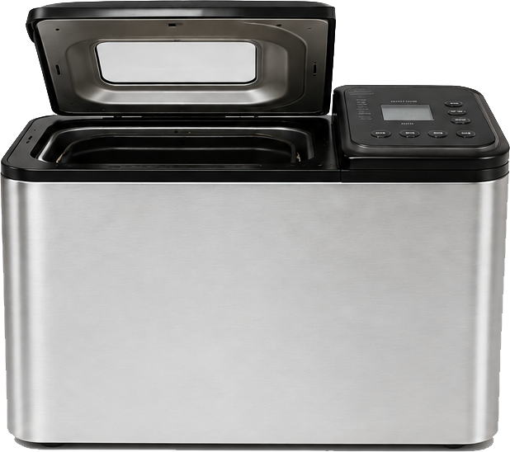
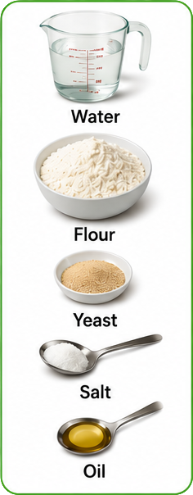
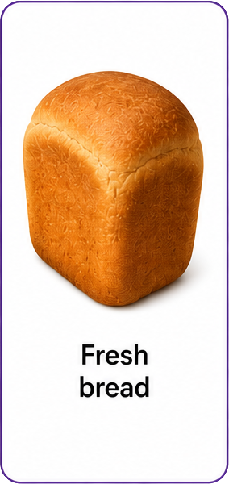
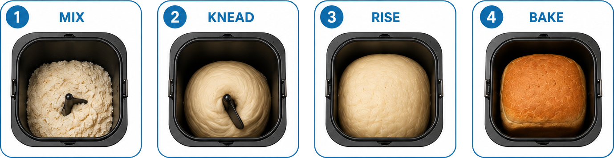
Functions - Overview
In code, only the input and output seen, not the process
Bread Maker
Input
Process
Output

Slide 61
Functions - Overview
Bread Maker

Slide 62
Function – Example
Parentheses
(Brackets)
print("Hello world")
Function name
Parameter(s) – Input
Function name and parentheses required
Parameters can be optional
Notes:
Decimal places can be omitted: round(6·23) → 6

Slide 63
Function – Example
print("Hello world")
Notes:
Decimal places can be omitted: round(6·23) → 6

Slide 64
Functions – Overview (1)
Process
Input
Output
A function does 'something'

Slide 65
Functions – Overview (1)

Slide 66
Functions – Overview (2)
Function
(Process)
Input
Output
Wash
Dirty clothes
Clean clothes
Capitalise
"hello"
"Hello"
Add together
7, 2
9

Slide 67
Functions – Overview (2)

Slide 68
Using Functions
1 print("Hello world")
2
3 text = "Hello world"
4 print(text)
Literal used
Variable used

Slide 69
Using Functions
1 print("Hello world")
2
3 text = "Hello world"
4 print(text)

Slide 70
Learning Intentions
Describe and use the predefined function: round

Slide 71
Round (Overview)
Function
Input
Output
Round
to dp
3·1415, 3
3·142
round()
3·1415, 2
3·14
round()
3·1415
3
Input: Real, Integer (optional)
Output: Real / Integer

Slide 72
Round (Overview)
Function
Input
Output
3·1415, 3
3·1415, 2
3·1415
Input:
Output:

Slide 73
round() – Example
Output
myValue =
round(3·1415, 2)
Function
Input
Decimal places can be omitted: round(6·23) → 6
Input to the function can be variables
Notes:
Decimal places can be omitted: round(6·23) → 6

Slide 74
round() – Example
myValue =
round(3·1415, 2)
Decimal places can be omitted: round(6·23) →
Input to the function can be
Notes:
Decimal places can be omitted: round(6·23) → 6
Python rounds 0·5 to the nearest even number: round(6·5) → 6

Slide 75
Rounding to an Integer (Python)
Integer
Integer
x ·1 ·2 ·3 ·4 ·5 ·6 ·7 ·8 ·9 x+1
?
round(3.5)
→ 4
round(4.5)
→ 4
Tied: rounds to nearest even integer
Notes:
Specific to Python

Slide 76
Rounding to an Integer (Python)
x ·1 ·2 ·3 ·4 ·5 ·6 ·7 ·8 ·9 x+1

Slide 77
Learning Intentions
Describe and use string concatenation

Slide 78
Joining words together
Hello
world
Notes:
Humans join words together to make meaning / sense

Slide 79
Joining strings together - concatenation
"Hello"
+
"world"
Notes:
Using a computer, strings can be joined together to make meaning / sense
“Glues” together

Slide 80
Concatenation Example
word1 | word2
"Hello"
1 word1 = "Hello"
2 word2 = "world"
3
4 print(word1 + word2)
5
6 print(word1 + " " + word2)
"world"
Concatenate
Concatenate
Concatenate: strings and / or variables of string data type
Notes:
Screenshot and paste output into notes

Slide 81
Concatenation Example
word1 | word2
1 word1 = "Hello"
2 word2 = "world"
3
4 print(word1 + word2)
5
6 print(word1 + " " + word2)
Concatenate:

Slide 82
Concatenation
Joins
strings
together
Not integers, real, or Boolean values
Notes:
What about other data types?

Slide 83
Concatenation

Slide 84
Learning Intentions
Describe and use casting to a string
Notes:
Not part of N5 specification but needed for concatention

Slide 85
Cast (convert) to String
Function
Input
Output
Cast to string
42
"42"
str()
3.14
"3.14"
str()
True
"True"
Input: Non-string
Output: String

Slide 86
Cast (convert) to String
Function
Input
Output
Input:
Output:

Slide 87
str() - Example
Output
myString =
str(42)
Function
Input
Casts non-string to string
Input can be a variable

Slide 88
str() - Example
myString =
str(42)

Slide 89
Python Example – Casting
word1 | num1
"Height:"
1 word1 = "Height:"
2 num1 = 1.56
3
4 text = word1 +
5
6 print(text)
1.56
text
" " +
str(num1)
"Height: 1.56"
Cast to string
Notes:
Could add a space at the end of "Height: ", but poor

Slide 90
Python Example – Casting
word1 | num1
"Height:"
1 word1 = "Height:"
2 num1 = 1.56
3
4 text = word1 +
5
6 print(text)
"1.56"
text
"Height: 1.56"

Slide 91
Learning Intentions
Describe and use keyboard input
Notes:
Not part of N5 specification but need: input( ), int( ), float( ), str( )
Could use eval( ) for numbers but don't

Slide 92
User input
Function
Input
Output
Get user input
"Enter name"
"Tom"
"Enter pi"
input()
"3.14"
input()
"Enter age"
"17"
Input: String (optional)
Output: String

Slide 93
User input
Function
Input
Output
Input:
Output:

Slide 94
input() – Example
input( ) function
Output
name = input("What is your name? ")
Displayed on the screen (optional)
Everything from the keyboard is a string!
Notes:
Computer waits for user input from the keyboard. Whatever is entered is a string, no matter what it looks like, i.e. if the user enters 42 it is not a number but a string.

Slide 95
input() – Example
name = input("What is your name? ")

Slide 96
Python Example – input()
value1 | value2
1 value1 = input("1st: ")
2 value2 = input("2nd: ")
3 result = value1 + value2
4 print(result)
result
Everything from the keyboard is a string!
Notes:
https://whiteboard.fi/
1. Run through with strings : "Big" + "dog" = "Bigdog"
2. Run through with ‘integers’: "4" + "2" = "42"

Slide 97
Python Example – input()
value1 | value2
1 value1 = input("1st: ")
2 value2 = input("2nd: ")
3 result = value1 +
4 print(result)
result

Slide 98
Learning Intentions
Describe and use casting to a number
Notes:
Not part of N5 specification but need: input( ), int( ), float( )
Could use eval( ) for numbers but don't

Slide 99
Cast (convert) to Integer
Function
Input
Output
Cast to integer
"42"
42
int()
"0"
0
int()
"-9"
-9
Input: String
Output: Integer

Slide 100
Cast (convert) to Integer
Function
Input
Output
Input:
Output:

Slide 101
int() - Example
Output
myInteger =
int("42")
Function
Input
Converts string to integer
Input can be a variable

Slide 102
int() - Example
myInteger =
int("42")

Slide 103
Cast (convert) to Real
Function
Input
Output
Cast to real
"4.2"
4.2
float()
"0"
0.0
float()
"-9.6"
-9.6
Input: String
Output: Real

Slide 104
Cast (convert) to Real
Function
Input
Output
Input:
Output:

Slide 105
float() - Example
Output
myReal =
float("4.2")
Function
Input
Converts string to real
Input can be a variable

Slide 106
float() - Example
myReal =
float("4.2")

Slide 107
Using Multiple Functions
Function 1
Function 2
Input
Output / Input
Output
input()
"17"
int()
"Age?"
17
input()
"3.14"
float()
"Pi?"
3.14
Output of one function = input of the next function

Slide 108
Using Multiple Functions
Function 1
Function 2
Input
Output / Input
Output
of one function = of the next function

Slide 109
input() & int() - Example
Output 1 /
Input 2
Output 2
age =
int( )
input("Age? ")
Function 2
Input 1
Function 1

Slide 110
input() & int() - Example
age =
int( )
input("Age? ")

Slide 111
Python Example – Functions
value1 | value2
1 value1 = int(input("1st: "))
2 value2 = int(input("2nd: "))
3 result = value1 + value2
4 print("Result: " + str(result))
result
Notes:
Run through with integers: 4 + 2 = 6

Slide 112
Python Example – Functions
value1 | value2
1 value1 = (input("1st: "))
2 value2 = int(input("2nd: "))
3 result = value1 +
4 print("Result: " +
result

Slide 113
Learning Intentions
Describe and use fixed loops

Slide 114
Sequences
Stop – Start: Number of values
Start value
range(1, 5)
1, 2, 3, 4
range( ) function
Stop value
range(5)
0, 1, 2, 3, 4
All values
are integers
Stop value (starts at 0)
Last value: Stop - 1
Notes:
If a start value isn’t specified, then it’s 0 (zero).
Info only: list(range(1, 10)) → [1, 2, 3, 4, 5, 6, 7, 8, 9]

Slide 115
Sequences
range(1, 5)
range(5)
Notes:
If a start value isn’t specified, then it’s 0 (zero).
Info only: list(range(1, 10)) → [1, 2, 3, 4, 5, 6, 7, 8, 9]

Slide 116
Fixed Loop – Start Value
Start value
Colon
Loop variable
1 for counter in range(1, 5):
2
3 print(counter)
4
5 print("Finished!")
Code to be repeated indented
Notes:
Keywords: for, in
Function: range( )
If a start value isn’t specified, then it’s 0 (zero).

Slide 117
Fixed Loop – Start Value
1 for counter in range(1, 5):
2
3 print(counter)
4
5 print("Finished!")
Notes:
Keywords: for, in
Function: range( )
If a start value isn’t specified, then it’s 0 (zero).

Slide 118
Fixed Loop – No Start Value
Colon
Loop variable
1 for number in range(5):
2
3 print(number + 1)
4
5 print("Finished!")
Code to be repeated indented
Notes:
Keywords: for, in
Function: range( )
If a start value isn’t specified, then it’s 0 (zero).

Slide 119
Fixed Loop – No Start Value
1 for number in range(5):
2
3 print(number + 1)
4
5 print("Finished!")
Notes:
Keywords: for, in
Function: range( )
If a start value isn’t specified, then it’s 0 (zero).

Slide 120
Learning Intentions
Describe and use a standard algorithm for a running total within a loop

Slide 121
Running total - Fixed Loop
Add multiple values together in a loop
1 value: int = 0
2 total: int = 0
3
4 for counter in range(4):
5
6 value = int(input("Value: "))
7
8 total = total + value
Initialise variables
How many values to add
Get new value
Add to total
Notes:
Use trace table

Slide 122
Running total - Fixed Loop
1 value = 0
2 total = 0
3
4 for counter in range(4):
5
6 value = int(input("Value: "))
7
8 total = total + value
Notes:
Use trace table

Slide 123
Learning Intentions
Describe and use:
  Python shell
  print
  input
Notes:
????

Slide 124
Learning Intentions
Describe and use:
  meaningful identifiers
  internal commentary
  white space
  indentation
Notes:
Indentation covered later

Slide 125
Readability
1 cow = 5
2 sea = 3
3 bob = sea + cow
4 print("Sum: " + str(bob))
1 value1 = 5
2 value2 = 3
3 total = value1 + value2
4 print("Sum: " + str(total))
1. Meaningful identifiers
Notes:
Code is to store two values, add them together, and display the result

Slide 126
Readability
1 cow = 5
2 sea = 3
3 bob = sea + cow
4 print("Sum: " + str(bob))
1 # Store two values
2 value1 = 5
3 value2 = 3
4 # Calculate the total
5 total = value1 + value2
6 # Display the result
7 print(Sum: " + str(total))
1. Meaningful identifiers
2. Internal commentary

Slide 127
Readability
1 cow = 5
2 sea = 3
3 bob = sea + cow
4 print("Sum: " + str(bob))
1 # Store two values
2 value1 = 5
3 value2 = 3
4
5 # Calculate the sum
6 total = value1 + value2
7
8 # Display the result
9 print("Sum: " + str(total))
1. Meaningful identifiers
2. Internal commentary
3. White space
4. Indentation (not shown)
Notes:
Initial: Very poor Final: Much better
Python forces indentation to be used – no example shown

Slide 128
Readability
1 cow = 5
2 sea = 3
3 bob = sea + cow
4 print("Sum: " + str(bob))
1 # Store two values
2 value1 = 5
3 value2 = 3
4
5 # Calculate the sum
6 total = value1 + value2
7
8 # Display the result
9 print("Sum: " + str(total))
Notes:
Initial: Very poor Final: Much better
Python forces indentation to be used – no example shown

Slide 129
Learning Intentions
Describe and use:
  meaningful identifiers
  internal commentary
  white space
  indentation

Slide 130
Indentation
Colon
spaces at the start of a line
indicates a block of code
Python: very important
Python: follows a colon
1 for counter in range(1, 6):
2
3 # Display value
4 print(counter)
5
6 # Display squared value
7 print(counter ** 2)
8
9 print("All done!")
Code block
Code block end
(Not indented)

Slide 131
Indentation
spaces at the
indicates a
Python:
Python: follows
1 for counter in range(1, 6):
2
3 # Display value
4 print(counter)
5
6 # Display squared value
7 print(counter ** 2)
8
9 print("All done!")

Slide 132
Program Layout
TAD
Import code
Initialise variables – correct data types
Get values from user – assign (cast if necessary)
Use values from user
Display results – concatenate (cast if necessary)
1. Input
2. Process
3. Output

Slide 133
Program Layout
TAD
Import
Initialise
Get values
Use values
Display

Slide 134
Learning Intentions
Describe and use simple conditions

Slide 135
Boolean
True
1
On
Yes
False
0
Off
No

Slide 136
Boolean

Slide 137
Comparison Operators
/ Relational Operators
==
>
>=
<
<=
!=
Equality, the same
Greater than
Greater than or equal to
Less than
Less than or equal to
Inequality, not the same

Slide 138
Comparison Operators
==
>
>=
<
<=
!=

Slide 139
True or False?
5 == 5
5 < 3
6 != 9
89 >= 89
val1 = 7.5 val2 = 7.5
val1 == val2
"A" == "a"
True != False
True
False
True
True
True
False
True
Notes:
Use Thonny shell / console

Slide 140
True or False?
5 == 5
5 < 3
6 != 9
89 >= 89
val1 = 7.5 val2 = 7.5
val1 == val2
"A" == "a"
True != False

Slide 141
Learning Intentions
Describe and use selection with simple conditions

Slide 142
Decisions
If your eyes are blue, raise your hand
If your hair is dark, put a finger on your nose
If the test is True, do something
If the test is False, do nothing

Slide 143
if – Single Selection
Example 1
Example 2
1 2 3 4 5 6 7 | number = 5 if number > 0: # If true print("Hi") print("Bye")
1 2 3 4 5 6 7 | number = -5 if number > 0: # If true print("Hi") print("Bye")
True
False

Slide 144
if – Single Selection
1 2 3 4 5 6 7 | number = 5 if number > 0: # If true print("Hi") print("Bye")
1 2 3 4 5 6 7 | number = -5 if number > 0: # If true print("Hi") print("Bye")

Slide 145
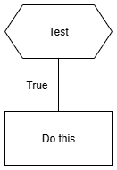
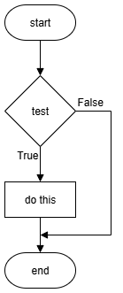
Design – if
Structure diagram
Flowchart
if
if

Slide 146
Design – if
Structure diagram
Flowchart

Slide 147
Learning Intentions
Describe and use selection with simple conditions

Slide 148
Decisions
If your eyes are blue, raise your hand
    Otherwise, put a finger on your nose
If your hair is dark, put a finger on your nose
    Otherwise, raise your hand
If the test is True, do something
If the test is False, do something else

Slide 149
if, else
Example 1
Example 2
1 number = 5
2
3 if number == 5:
4 # True
5
6 else:
7 # False
1 number = -5
2
3 if number == 5: 4 # True
5
6 else:
7 # False
True
False

Slide 150
if, else
1 number = 5
2
3 if number == 5:
4 # True
5
6 else:
7 # False
1 number = -5
2
3 if number == 5: 4 # True
5
6 else:
7 # False

Slide 151
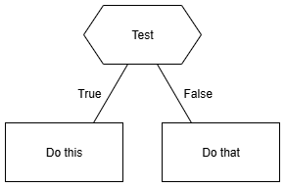
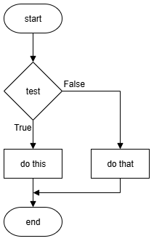
Design – if, else
Structure diagram
Flowchart
if
else
if
else

Slide 152
Design – if, else
Structure diagram
Flowchart

Slide 153
Learning Intentions
Describe and use selection with simple conditions

Slide 154
Nested if – Multiple Selection
1 number = int(input("Enter a whole number: "))
2
3 if number > 0:
4 # True
5
6 else:
7 if number < 0:
8 # True
9
10 else:
11 # False
Tests done in order
Multiple nested
ifs allowed
Nested if
(inside else)
else not mandatory

Slide 155
Nested if – Multiple Selection
1 number = int(input("Enter a whole number: "))
2
3 if number > 0:
4 # True
5
6 else:
7 if number < 0:
8 # True
9
10 else:
11 # False

Slide 156
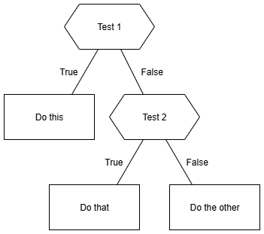
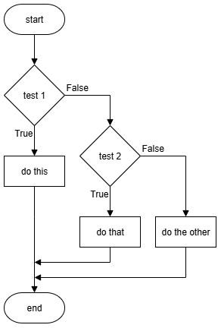
Design – Nested if
else is optional
Structure diagram
Flowchart
if
if
Nested if
Nested if
else
else

Slide 157
Design – Nested if
Structure diagram
Flowchart

Slide 158
Learning Intentions
Describe and use the predefined function: length

Slide 159
Length – String (Overview)
Function
Input
Output
Count
Characters
"Hello"
5
len()
"C@t"
3
len()
"17"
2
Input: String
Output: Integer

Slide 160
Length – String (Overview)
Function
Input
Output
Input:
Output:

Slide 161
len() – String – Example
Output
myValue =
len("Hello")
Function
Input
Counts the characters
Input to the function can be a variable

Slide 162
len() – String – Example
myValue =
len("Hello")
Counts the
Input to the function can be a

Slide 163
Learning Intentions
Describe and use selection with simple conditions

Slide 164
if, else if, else – Multiple Selection
1 number = int(input("Enter a whole number: "))
2
3 if number > 0:
4 # True
5
6 elif number < 0:
7 # True
8
9 else:
10 # False
Tests done in order
Multiple elif allowed
else is optional

Slide 165
if, else if, else – Multiple Selection
1 number = int(input("Enter a whole number: "))
2
3 if number > 0:
4 # True
5
6 elif number < 0:
7 # True
8
9 else:
10 # False

Slide 166
Design – if, elif, else
else is optional
Structure diagram
Flowchart
if
if
else if
else if
else
else

Slide 167
Design – if, else if, else
Structure diagram
Flowchart

Slide 168
else if – Tip
1 number = int(input("Enter a whole number: "))
2
3 if number > 0:
4 # True
5
6 elif number < 0:
7 # True
8
9 else:
10 # False
Tests done in order
Multiple elif allowed
else is optional
Notes:
0-2 Too young, 3-4 Nursery, 5-11 Primary, 12-18 Secondary, 19+ Too old

Slide 169
Learning Intentions
Describe and use logical operators (AND, OR, NOT)

Slide 170
AND – Logical Operator
Condition 1 | Condition 2 | Overall
False | False | False
False | True | False
True | False | False
True | True | True
All conditions must be True – All or nothing!

Slide 171
AND – Logical Operator
Condition 1 | Condition 2 | Overall

Slide 172
AND – True or False?
False
5 < 2 AND 9 > 3
3 > 1 AND 8 > 4
8 > 7 AND 6 < 2
89 >= 98 AND 8 == 9
17 != 17 AND 17 == 17
"A" != "a" AND "B" > "A"
False
True
False
False
False
True
True
True
True
False
If first condition is
False
all others ignored!
False
False
True
True
Notes:
If first condition is False, all other conditions are ignored.

Slide 173
AND – True or False?
5 < 2 AND 9 > 3
3 > 1 AND 8 > 4
8 > 7 AND 6 < 2
89 >= 98 AND 8 == 9
17 != 17 AND 17 == 17
"A" != "a" AND "B" > "A"

Slide 174
OR – Logical Operator
Condition 1 | Condition 2 | Overall
False | False | False
False | True | True
True | False | True
True | True | True
One or more conditions must be True – Any will do!

Slide 175
OR – Logical Operator
Condition 1 | Condition 2 | Overall

Slide 176
OR – True or False?
True
3 > 1 OR 8 > 4
7 > 8 OR 2 < 6
89 >= 98 OR 8 == 9
17 != 17 OR 17 == 17
"A" == "a" OR "B" > "A"
True
True
False
True
True
False
True
If first condition is
True
all others ignored!
False
False
False
True
False
True
Notes:
If first condition is True, all other conditions are ignored.

Slide 177
OR – True or False?
3 > 1 OR 8 > 4
7 > 8 OR 2 < 6
89 >= 98 OR 8 == 9
17 != 17 OR 17 == 17
"A" == "a" OR "B" > "A"

Slide 178
NOT – Logical Operator
Condition | Overall
False | True
True | False
Opposites!

Slide 179
NOT – Logical Operator
Condition | Overall

Slide 180
NOT – True or False?
False
NOT ( 5 < 2 )
NOT ( 3 > 1 AND 4 > 8 )
NOT ( 8 > 9 OR 6 <= 6 )
True
True
False
True
False
( False )
False
True
( True )

Slide 181
NOT – True or False?
NOT ( 5 < 2 )
NOT ( 3 > 1 AND 4 > 8 )
NOT ( 8 > 9 OR 6 <= 6 )

Slide 182
Learning Intentions
Describe and use selection with complex conditions
Notes:
No slides

Slide 183
Example 1 – Body Temperature
1 temp = float(input("Body temp (deg C): "))
2
3 if temp >= 36.1 and temp <= 37.2:
4 print("Normal body temperature")
5 else:
6 print("Not normal body temperature")
Notes:
Source: https://medlineplus.gov/ency/article/001982.htm

Slide 184
Example 1 – Body Temperature
1 temp = float(input("Body temp (deg C): "))
2
3 if temp >= 36.1 and temp <= 37.2:
4 print("Normal body temperature")
5 else:
6 print("Not normal body temperature")
How many extreme values (1 dp) are needed?
Notes:
Source: https://medlineplus.gov/ency/article/001982.htm
Create test table then implement

Slide 185
Example 2 – Theme Park Ride
1 age = int(input("Age (years): "))
2
3 height = float(input("Height (metres): "))
4
5 if age >= 10 and height >= 1.2:
6 print("All criteria met")
Notes:
Theme park ride. Minimum age and minimum height restrictions.

Slide 186
Example 2 – Theme Park Ride
1 age = int(input("Age (years): "))
2 height = float(input("Height (metres): "))
3
4 if age >= 10 and height >= 1.2:
5 print("All criteria met")
Create test. Implement. Test.
Notes:
Theme park ride. Minimum age and minimum height restrictions.
Create test table then implement / Supersize with elif, else to shown failed criteria.

Slide 187
Task – Jockeys
Professional jockeys are small and light.
Determine if someone is a potential jockey.
They must have:
Maximum height of 1 metre, i.e. 1.00
Maximum weight of 15 kg, i.e. 15.0
Display some kind words if there are / are not suitable.

Slide 188
Task – Jockeys
Professional jockeys are small and light.
Determine if someone is a potential jockey.
They must have:
Maximum height of 1 metre, i.e. 1.00
Maximum weight of 15 kg, i.e. 15.0
Display some kind words if they're not suitable.
Design user interface. Create tests. Implement. Test.
Notes:
Completely made-up criteria!
Design interface, create test table, implement, test

Slide 189
Learning Intentions
Describe and use efficient selection

Slide 190
Efficient coding (1)
Inefficient
Efficient
Two
tests
One
test
Faster,
Simpler
1 if score >= 60:
2 print("Pass")
3
4 if score < 60:
5 print("Fail")
1 if score >= 60:
2 print("Pass")
3
4 else:
5 print("Fail")

Slide 191
Efficient coding (1)
1 if score >= 60:
2 print("Pass")
3
4 if score < 60:
5 print("Fail")
1 if score >= 60:
2 print("Pass")
3
4 else:
5 print("Fail")

Slide 192
Selection – if, else if, else (3 or more options)
Generic
Python
IF <condition 1> is true THEN
do something
ELSE IF <condition 2> is true THEN
do something else
ELSE
do this instead
END IF
if 5 < 2:
print("True")
elif 5 == 2:
print("Another option")
else:
print("All False")
Else can be omitted

Slide 193
Selection – if, else if, else (3 or more options)
Generic
Python
IF <condition 1> is true THEN
do something
ELSE
do this instead
END IF
if 5 < 2:
print("True")
else:
print("All False")

Slide 194
Efficient coding (2)
Else if (multiple allowed)
Inefficient
Efficient
1 if age >= 67:
2 print("Retired")
3
4 if age >= 18 and age < 67:
5 print("Working aged")
6
7 if age < 18:
8 print("School aged")
1 if age >= 67:
2 print(" Retired")
3
4 elif age >= 18:
5 print("Working aged")
6
7 else:
8 print("School aged")
3 or 4 conditions tested
1 or 2 conditions tested
Notes:
Inefficient: every condition is evaluated, every time
Efficient: at first True condition selection terminates
run through with 20

Slide 195
Efficient coding (2)
1 if age >= 67:
2 print("Retired")
3
4 if age >= 18 and age < 67:
5 print("Working aged")
6
7 if age < 18:
8 print("School aged")
1 if age >= 67:
2 print(" Retired")
3
4 elif age >= 18:
5 print("Working aged")
6
7 else:
8 print("School aged")

Slide 196
Task – SQA Grades
SQA exam results are graded:
  A 70-100
  B 60-69
  C 50-59
  D 40-49
  No Award 0-39
Assumptions
All values integers
Values will be 0-100
Create a test table first!
Notes:
Create test table then implement

Slide 197
Learning Intentions
Describe and use the predefined function: random

Slide 198
Random (Overview)
Function
Input
Output
Pick random
1, 6
4
Min,
Max
randint()
0, 100
72
Min,
Max
randint()
85, 115
87
Min,
Max
Input: Integers
Output: Integer

Slide 199
Random (Overview)
Function
Input
Output
Pick random
1, 6
randint()
0, 100
randint()
85, 115
Input:
Output:

Slide 200
random – Example
Get extra code
1 import random
Name of extra code
Output
min
max
2 myValue =
random.randint(1, 26)
Function
Input
randint() is a function in the random module
Input to the function can be variables

Slide 201
random – Example
1 import random
2 myValue =
random.randint(1, 26)
randint() is a function in the
Input to the function can be

Slide 202
Task – Throwing a dice
Get extra code for random
Loop 5 times
  'Throw' a dice
  Show what the computer threw
Notes:
Die – singular / Dice – plural

Slide 203
Learning Intentions
Describe and use normal test data in a test table
Describe and identify syntax, execution, and logic errors

Slide 204
Error Types
Syntax – program won't run / compile
Execution – program stops running
Logic – executes but wrong result – hardest to find
Notes:
Syntax: Print("Hello)
Execution: 2 + "2"

Slide 205
Error Types
Syntax –
Execution –
Logic –

Slide 206
Normal Test Data
Normal – values that are expected
Test Data – selected before testing
Expected output – what should be produced
Actual output – what is produced
Normal
Simulate a die: -2, -1, 0, 1, 2, 3, 4, 5, 6, 7, 8 , 9
Notes:
Normal: 1-6

Slide 207
Normal Test Data
Normal –
Test Data –
Expected output –
Actual output –
Simulate a die: -2, -1, 0, 1, 2, 3, 4, 5, 6, 7, 8 , 9

Slide 208
Test table – Normal
Problem: add two values
Test data | Test type | Expected | Actual | Comment
2 and 2 | Normal | 4 | 4 | Pass
2 and 3 | Normal | 5 | 6 | Fail
2 and 10 | Normal | 12 | 20 | Fail
Do this before writing code
Do this when running tests
Iterate until it passes all the tests!
Notes:
Test table layout is not fixed- amend as necessary

Slide 209
Test table – Normal
Problem: add two values
Test data | Test type | Expected | Actual | Comment
 | Normal
 | Normal
 | Normal

Slide 210
Learning Intentions
Describe and use extreme test data in a test table
Describe and identify syntax, execution, and logic errors
Notes:
Extreme – at the limits / edge

Slide 211
Extreme Test Data
Extreme – at limit of selection – both sides
1 number = int(input("Number: "))
2
3 if number < 0:
4 print("Negative")
Extreme Values
Line 1 | Number
Line 3 | Boolean
-3 -2 -1 0 1 2
True
True
True
False
False
False
Notes:
Add: T T F F F
Mark: extreme values

Slide 212
Extreme Test Data
Extreme – at limit of selection – both sides
1 number = int(input("Number: "))
2
3 if number < 0:
4 print("Negative")
Line 1 | Number
Line 3 | Boolean
-3 -2 -1 0 1 2
Notes:
Add: T T F F F
Mark: extreme values

Slide 213
Test table – Extreme
Problem: Determine if an integer bigger than 10
Test data | Test type | Expected | Actual | Comment
5 | Normal | False | False | Pass
10 | Extreme | False | True | Fail
11 | Extreme | True | True | Pass
Do this before writing code
Do this when running tests
Iterate until it passes all the tests!

Slide 214
Test table – Extreme
Problem: Determine if an integer bigger than 10
Test data | Test type | Expected | Actual | Comment
 | Normal
 | Extreme
 | Extreme

Slide 215
Learning Intentions
Describe and use conditional loops

Slide 216
Conditional Loop
WHILE condition is True DO
something
END WHILE
Code to be repeated
Code is only run if the condition is True
Notes:
Only enter the loop when the condition is True.
Only exit the loop when the condition is False.

Slide 217
Conditional Loop
condition is True DO
END

Slide 218
Conditional Loop
1 number = int(input("Number: "))
2
3
4 while number < 10:
5 number = number + 1
6 print(number)
Keyword
Condition
True
False
Code repeats while the condition is True
Notes:
what happens if <age> is 3, 5, 9 ?
Condition can be complex

Slide 219
Conditional Loop
1 number = int(input("Number: "))
2
3
4 while number < 10:
5 number = number + 1
6 print(number)

Slide 220
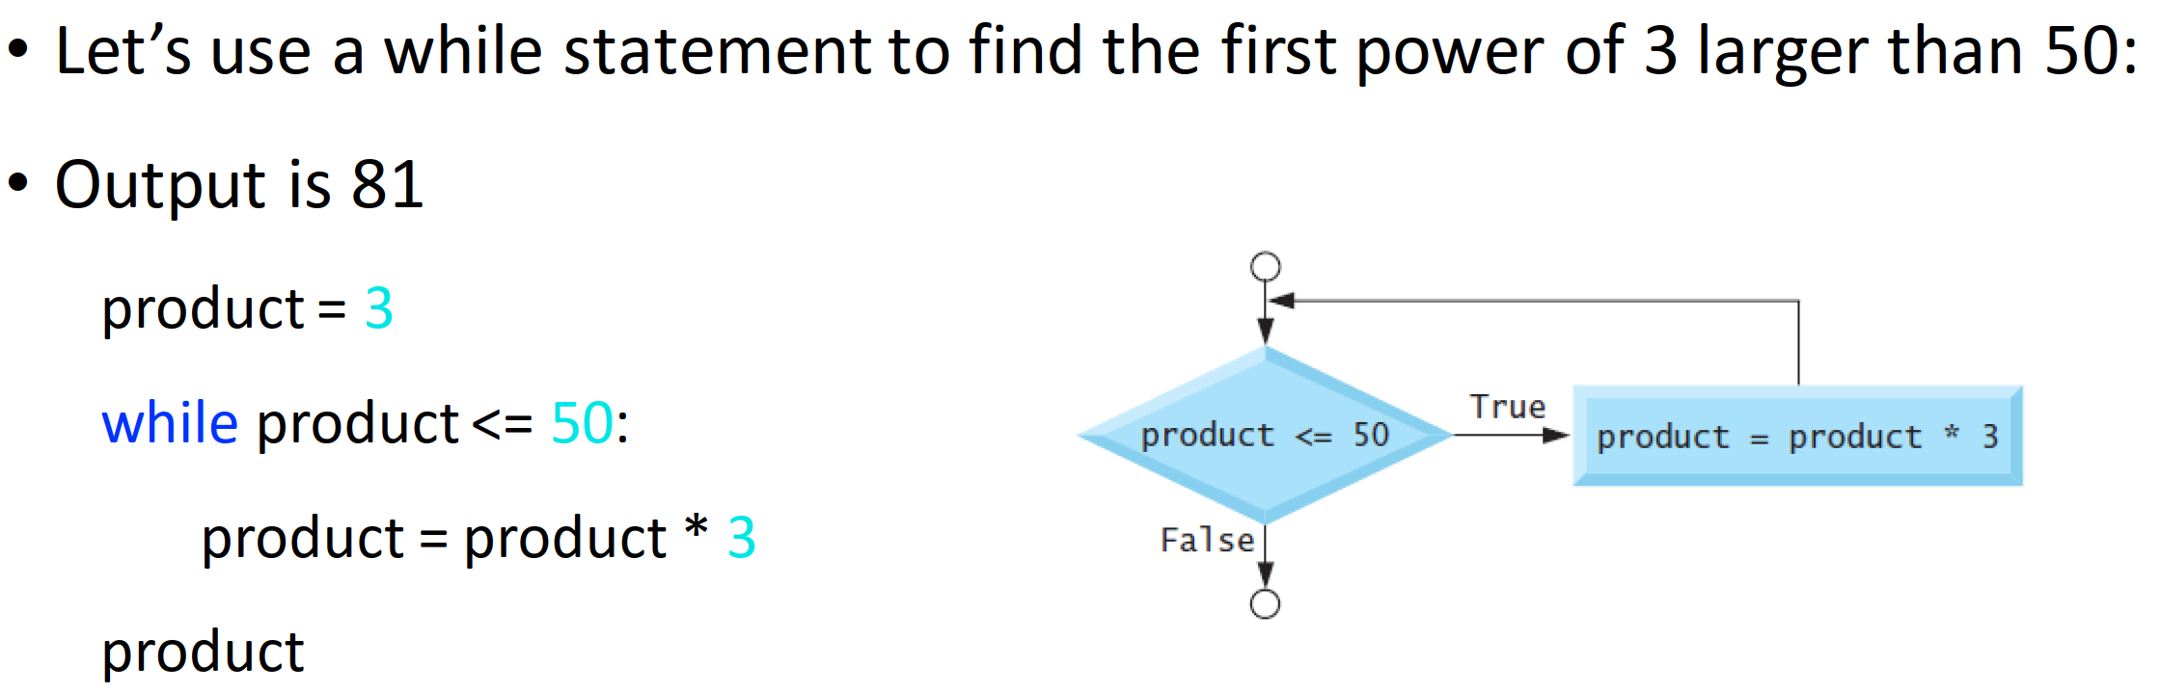
While

Slide 221
Learning Intentions
Describe and use a standard algorithm for input validation
Notes:
Used to limit input values to acceptable values

Slide 222
User input
1 pax = int(input("Passengers: "))
2
3 print("Taxi for " + str(pax))
Notes:
Simple condition

Slide 223
Input validation – Input Before Loop - Overview
1 Get user input
2 Repeat until condition is FALSE
3 Display error message
4 Get user input

Slide 224
Input validation – Input Before Loop - Overview
1 Get
2 Repeat until
3 Display
4 Get

Slide 225
Input Validation – Integers – Simple
User input
1 pax = int(input("Passengers: "))
2
3 while pax < 1:
4
5 print("Must be at least 1.")
6
7 pax = int(input("Passengers: "))
Must be True to begin
Error message: meaningful
User input
Conditional loop not used if Line 3 is False
Notes:
Simple condition. Error message to be meaningful, i.e. better than "Invalid"
Number of taxi passengers

Slide 226
Input Validation – Integers – Simple
1 pax = int(input("Passengers: "))
2
3 while pax < 1:
4
5 print("Must be at least 1.")
6
7 pax = int(input("Passengers: "))
8

Slide 227
Input Validation – Integers – Complex
User input
1 pax = int(input("Passengers: "))
2
3 while pax < 1 and pax > 5:
4
5 print("Must be between 1 and 5.")
6
7 pax = int(input("Passengers: "))
Logical operator
Error message: meaningful
User input
Conditional loop not used if Line 3 is False
Notes:
Simple condition. Error message to be meaningful, i.e. better than "Invalid"
Number of taxi passengers

Slide 228
Input Validation – Integers – Complex
1 pax = int(input("Passengers: "))
2
3 while pax < 1 and pax > 5:
4
5 print("Must be between 1 and 5.")
6
7 pax = int(input("Passengers: "))
Conditional loop not used if Line 3 is False

Slide 229
Input Validation – Strings – Simple
User input
1 answer = input("Is computing best? ")
2
3 while answer != "yes":
4
5 print("Have another think!")
6
7 answer = input("Is computing best? ")
Must be True to begin
Error message: meaningful
User input
Conditional loop not used if Line 3 is False

Slide 230
Input Validation – Strings – Simple
1 answer = input("Is computing best? ")
2
3 while answer != "yes":
4
5 print("Have another think!")
6
7 answer = input("Is computing best? ")
Conditional loop not used if Line 3 is False

Slide 231
Learning Intentions
Describe and use extreme test data in a test table
Describe and identify execution and logic errors
Notes:
Extreme – at the limits / edge

Slide 232
Extreme Test Data
Extreme – normal test data but at limit of:
  acceptable values
  decisions (selection) – either side
Normal
Simulate a die: -2, -1, 0, 1, 2, 3, 4, 5, 6, 7, 8 , 9
Extreme

Slide 233
Extreme Test Data
Extreme – normal test data but at limit of:
  acceptable values
  decisions (selection) – either side
Simulate a die: -2, -1, 0, 1, 2, 3, 4, 5, 6, 7, 8 , 9

Slide 234
Learning Intentions
Describe and use exceptional test data in a test table
Describe and identify syntax, execution, and logic errors
Notes:
Exceptional – beyond the limits / not acceptable

Slide 235
Exceptional Test Data
Exceptional – values that are not acceptable
Normal
Simulate a die: -2, -1, 0, 1, 2, 3, 4, 5, 6, 7, 8 , 9
Extreme
Exceptional
Exceptional

Slide 236
Exceptional Test Data
Exceptional – values that
Simulate a die: -2, -1, 0, 1, 2, 3, 4, 5, 6, 7, 8 , 9

Slide 237
Test table – Exceptional
Problem: Accept integers that are 1 or more
Test data | Test type | Expected | Actual | Comment
5 | Normal | Accept | Accept | Pass
1 | Extreme | Accept | Accept | Pass
0 | Exceptional | Reject | Accept | Fail
Do this before writing code
Do this when running tests
Iterate until it passes all the tests!
Notes:
Test table layout is not fixed - amend as necessary

Slide 238
Test table – Exceptional
Problem: Accept integers that are 1 or more
Test data | Test type | Expected | Actual | Comment
 | Normal
 | Extreme
 | Exceptional

Slide 239
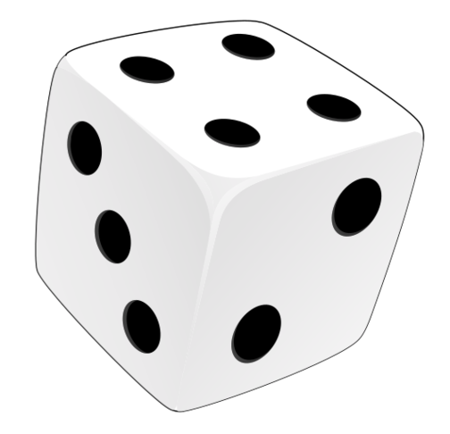
Conditional Loop – Testing
Enter the loop – exceptional test
Stay in the loop – exceptional test
Exit the loop – extreme test
Test Data | Test Type | Expected | Actual | Comment
3 | Normal | Accepted
6 | Extreme | Accepted
0 | Exceptional | Error message |  | 1. Enter
7 | Exceptional | Error message |  | 2. Stay in
1 | Extreme | Accepted |  | 3. Exit
Notes:
Value of a die

Slide 240
Conditional Loop – Testing
Test Data | Test Type | Expected | Actual | Comment
3 | Normal | Accepted
6 | Extreme | Accepted
0 | Exceptional | Error message
7 | Exceptional | Error message
1 | Extreme | Accepted

Slide 241
Random – Testing
71 # Pick a random number
72 number = random.randint(1, 10)
73
74 # NOTE: only used for testing logic
75 number = 2
Codetag
Overwrites random value
Comment out when not being used
Delete when finished with

Slide 242
Random – Testing
71 # Pick a random number
72 number = random.randint(1, 10)
73
74 # NOTE: only used for testing logic
75 number = 2
Comment out when
Delete when

Slide 243
Test Table – Random Values
Problem: Guess a number (1 – 10)
User | Comp | Test type | Expected | Actual | Comment
5 | ? | Normal | Display result
1 | ? | Extreme | Display result
0 | ? | Exceptional | Error / Re-enter
2 | 2 | Normal | "Correct" result
9 | 2 | Normal | "Incorrect" result
Random value or picked by tester
Notes:
Exceptional testing: Enter loop / Stay in loop / Exit loop – using extreme

Slide 244
Test Table – Random Values
Problem: Guess a number (1 – 10)
User | Comp | Test type | Expected | Actual | Comment
5 |  | Normal | Display result
1 |  | Extreme | Display result
0 |  | Exceptional | Error / Re-enter

Slide 245
Learning Intentions
Describe and use the 1-D array data structure
Notes:
Not a data type but a data structure

Slide 246
Variables – How many are needed?
A postcode
The ages of 5 pupils
Rainfall for every day of a year
postcode = "HS9 5XD"
age1 = 11
age2 = 14
age3 = 13
age4 = 14
age5 = 12
365 or 366 variables!
Multiple variables are inefficient

Slide 247
Multiple variables → An array
age1 = 11
age2 = 14
age3 = 13
age4 = 14
age5 = 12
[ , , , , ]
11
14
13
14
12
An array is a collection of values of the same datatype

Slide 248
Multiple variables → An array
age1 = 11
age2 = 14
age3 = 13
age4 = 14
age5 = 12
11
14
13
[ , , , , ]
14
12

Slide 249
Assignment – array
Array assigned
to variable
Array name
Values to be stored
ages = [11, 14, 13, 14, 12]
Assignment operator
Values are same data type. Plural used for array names.

Slide 250
Assignment – array
ages = [11, 14, 13, 14, 12]

Slide 251
Array elements / index
Elements
ages = [11, 14, 13, 14, 12]
Index value:
0
1
2
3
4
An array is a data structure

Slide 252
Array elements / index
ages = [11, 14, 13, 14, 12]

Slide 253
Python Example – Access Elements
0 1 2 3 4
1 ages = [11, 14, 15, 14, 13]
2 print(ages)
3
4 age = ages[1]
5 print(age)
6
7 old = ages[3] + 10
8 print(old)
Subscript operator
Index

Slide 254
Python Example – Access Elements
1 ages = [11, 14, 15, 14, 13]
2 print(ages)
3
4 age = ages[1]
5 print(age)
6
7 old = ages[3] + 10
8 print(old)

Slide 255
Python Example – Replace Elements
1 names = ["" for index in range(4)]
2 print(names)
3
4 names[2] = "Tom"
5 names[0] = "Emma"
6
7 print(names)
Python shorthand
(Do use!)
Index

Slide 256
Python Example – Replace Elements
1 names = ["" for index in range(4)]
2 print(names)
3
4 names[2] = "Tom"
5 names[0] = "Emma"
6
7 print(names)

Slide 257
Say What You See!
["Hip", "Hip"]

Slide 258
Learning Intentions
Describe and use the predefined function: length

Slide 259
Length – Array (Overview)
Function
Input
Output
Count
Elements
[1, 5, 9, 0]
4
len()
["In","At","Pi"]
3
len()
[True, False]
2
Input: Array
Output: Integer

Slide 260
Length – Array (Overview)
Function
Input
Output
[1, 5, 9, 0]
["In","At","Pi"]
[True, False]
Input:
Output:

Slide 261
len() – Array – Example
Output
myValue =
len([1, 5, 9])
Function
Input
Counts the elements
Input to the function can be a variable

Slide 262
len() – Array – Example
myValue =
len([1, 5, 9])
Counts the
Input to the function can be a

Slide 263
Learning Intentions
Describe and use a standard algorithm for traversing a 1-D array
Notes:
https://caledoniaplay.com/wp-content/uploads/2024/06/EDU-PRODUCT-DESCRIPTION-gallery-image-AGILITY-TRAVERSING-WALL-3.jpg

Slide 264
Traversing an array – Data in
1 ages = [0] * 5
2
3 for index in range(5):
4 age = int(input("Age? "))
5 ages[index] = age
Loop for 5 values
Loop variable
Get value
Assign to array

Slide 265
Traversing an array – Data in
1 ages = [0] * 5
2
3 for index in range(5):
4 age = int(input("Age? "))
5 ages[index] = age

Slide 266
Traversing an array – Data out (1)
1 ages = [11, 14, 13, 14, 12]
2
3 for index in range(len(ages)):
4 print(ages[index])
Loops for each element in array – Displays one at a time

Slide 267
Traversing an array – Data out (1)
1 ages = [11, 14, 13, 14, 12]
2
3 for index in range(len(ages)):
4 print(ages[index])
Loops for each element in array –

Slide 268
Test data - Summary
Test type | Description
Exceptional | Values to be rejected
Extreme | Values at the limit of what is acceptable
Normal | All acceptable values
Example: Accept integers from 1 to 10
Test type | Values
Exceptional | 0, 11, -700
Extreme | 1, 10
Normal | 1, 2, 3, 4, 5, 6, 7, 8, 9, 10
Notes:
0, 11, and -700 are rejected.
"five" and 7.3 cause a runtime error as string / float values (outside the scope of N5 & H).

Slide 269
Test data - Summary
Test type | Description
Exceptional | Values to be
Extreme | Values at the
Normal | All
Example: Accept integers from 1 to 10
Test type | Values
Exceptional
Extreme
Normal

Slide 270
Plan – N5 Year 2
SDD
Software Design and Development (54%)
DDD
Database Design and Development (33%)
Assignment (⅓ of marks)
Computer Systems (13%)
C/Sys
Exam (⅔ of marks)
Notes:
Prelim 1 about half way through DDD
Prelim 2 just before assignment

Slide 271
Plan – N5 Year 2
SDD
Software Design and Development (54%)
DDD
Database Design and Development (33%)
Computer Systems (13%)
C/Sys

Slide 272
Assessment
Assignment – 33%
Question Paper – 67%
SDD 67%
DDD 33%
Marks 40
SDD 54%
DDD 33%
Comp Sys 13%
Marks 80
Final grade out of 120
Notes:
Hide as appropriate

Slide 273
Assessment
Assignment – 40 Marks
Question Paper – 80 Marks
Analysis 3 – 6
Design 4 – 8
Implementation 22 – 24
Testing 3 – 6
Evaluation 3 – 6
Computer Systems 0
Analysis 0 – 5
Design 20 – 40
Implementation 16 – 34
Testing 5 – 10
Evaluation 0 – 5
Computer Systems 10 – 14
Final grade out of 120
Notes:
SDD: 0-5, 0-5, 15, 0-5, 0-5

Slide 274
Development methodologies

Slide 275
Learning Intentions
Describe and implement the phases of an iterative development process

Slide 276
Development Phases
Analysis
Design
Implementation
Testing
Documentation
Note:
Phases are different lengths
Evaluation

Slide 277
Development Phases

Slide 278
Development Phases
Analysis
Design
Implementation
Evaluation
Documentation
Testing

Slide 279
Development Phases

Slide 280
Phases Overview
How will it look?
What's wanted?
How to do it
Make it happen!
Does it work?
Write manuals
Does it do what was wanted?
Fit for purpose?
Code: readable, efficient, maintainable?

Slide 281
Phases Overview

Slide 282
Phases Overview
Analysis
Design
Implementation
What is wanted?
How will it be done / look like?
Write the code and make it happen!
Does it do what was wanted?
Create user and technical guides
Does it work?
Evaluation
Documentation
Testing

Slide 283
Phases Overview
Analysis
Design
Implementation
Evaluation
Documentation
Testing

Slide 284
Iterative Process
Iterative:
Do it again
Improve each time
Analysis
Design
Implementation
Testing
Documentation
Go back to any earlier stage
Evaluation
Notes:
iterative: doing something again (and again), usually to improve it

Slide 285
Iterative Process
Iterative:
Analysis
Design
Implementation
Testing
Documentation
Evaluation

Slide 286
Analysis

Slide 287
Learning Intentions
Identify the purpose and functional requirements of a problem that relates to the design and implementation, in terms of:
  inputs
  processes
  outputs

Slide 288
Purpose
A statement of what the program is supposed to do:
The program is to ask the user for 2 values and display the sum of the values

Slide 289
Purpose
The program is to ask the user for 2 values and display the sum of the values

Slide 290
Functional Requirements
The inputs, processes, and outputs that are required to achieve the purpose of the program
Input(s)
Process(es)
Output(s)
What must
the user enter?
What does the program do with the data?
Result of the calculation
Second value
Notes:
Purpose: The program is to ask the user for 2 values and display the sum of the values

Slide 291
Functional Requirements
Input(s)
Process(es)
Output(s)
What data must the user enter?
What sensor data is provided?
What does the program do with the data?
How does the program create the outputs?
What messages does the user see?
What data is sent to another program?

Slide 292
Functional Requirements
Input(s)
Process(es)
Output(s)
What data
What sensor
What does the
How does the
What messages
What data is

Slide 293
Functional Requirements
The inputs, processes, and outputs that are required to achieve the purpose of the program
Input(s)
Process(es)
Output(s)
First value
Add first value and second value together
Result of the calculation
Second value
Notes:
Purpose: The program is to ask the user for 2 values and display the sum of the values

Slide 294
Functional Requirements
The inputs, processes, and outputs
Input(s)
Process(es)
Output(s)

Slide 295
Design

Slide 296
Learning Intentions
Identify the data types and structures required for a problem that relates to the implementation at this level.

Slide 297
Learning Intentions
Describe, identify, and be able to read and understand:
  structure diagrams
  flowcharts
  pseudocode
Exemplify and implement one of the above design techniques to design efficient solutions to a problem.

Slide 298
Structure Diagrams
Steps to solve a problem
Process
Loop
Pre-defined
function
Selection

Slide 299
Structure Diagrams
Steps

Slide 300
Structure Diagrams – Example 1
Read top to bottom, left to right
Title / Description
0
Add two values
Initialise variables
Get first value from user
Get second value from user
Add values together
Display result
1
2
3
4
5
Notes:
Code it. Paste into OneNote page plus screenshots.

Slide 301
Structure Diagrams – Example 1
Read
Get first value from user
Get second value from user
Add values together

Slide 302
Structure Diagrams – Example 2
0
Top to bottom
Left to right
Find the average of 4 numbers
1
2
5
7
Initialise variables
Loop 4 times
Calculate average
Display average
3
4
6
Get number
Add number to total
Round to
1 dp
Notes:
Running total
Code it. Paste into OneNote page plus screenshots.

Slide 303
Structure Diagrams – Example 2
Find the average of 4 numbers
Initialise variables
Calculate average
Display average
Get number
Add number to total
Notes:
Running total

Slide 304
Structure Diagrams – Example 3
0
Top to bottom
Left to right
Determine
Pass / Fail
1
2
3
5
Initialise variables
Get valid mark
Is mark
>= 50?
Display result
Yes
4
Set result to pass
Notes:
Input validation / If
Code it. Paste into OneNote page plus screenshots.

Slide 305
Structure Diagrams – Example 3
Determine
Pass / Fail
Initialise variables
Get valid mark
Is mark
>= 50?
Display result
Set result to pass
Notes:
Input validation

Slide 306
Structure Diagrams – Example 3
0
Top to bottom
Left to right
Determine
Pass / Fail
1
2
3
5
Initialise variables
Get valid mark
Is mark
>= 50?
Display result
Yes
No
Set result to pass
Set result to
fail
4a
4b
(Only Yes or No, not both)
Notes:
Input validation / If Else
Code it. Paste into Onenote page plus screenshots.

Slide 307
Structure Diagrams – Example 3
Determine
Pass / Fail
Initialise variables
Get valid mark
Display result
Set result to pass
Set result to
fail

Slide 308
Learning Intentions
Describe, identify, and be able to read and understand:
  structure diagrams
  flowcharts
  pseudocode
Exemplify and implement one of the above design techniques to design efficient solutions to a problem.

Slide 309
Flowcharts
Begin at start
Follow the arrows
Finish at end
Input /
Output
Initialisation
Flow
Terminal
Connector
Pre-defined
function
Decision
Process

Slide 310
Flowcharts
Begin at
Follow the
Finish at

Slide 311
Flowcharts – Example 1
start
Declare variables
Get second user value
Display result
Get first user value
Add values together
end

Slide 312
Flowcharts – Example 1
Get second user value
Get first user value
Add values together

Slide 313
Flowcharts – Example 2
start
counter = 0
value = 0
total = 0
Get value
Add 1
to counter
Display total
"Enter 4 values"
Add value
to total
No
counter
= 4?
end
Yes
Notes:
Running total
Letters to ensure correct flow

Slide 314
Flowcharts – Example 2
start
counter = 0
value = 0
total = 0
Get value
Add 1
to counter
Display total
"Enter 4 values"
Add value
to total
counter
=
end

Slide 315
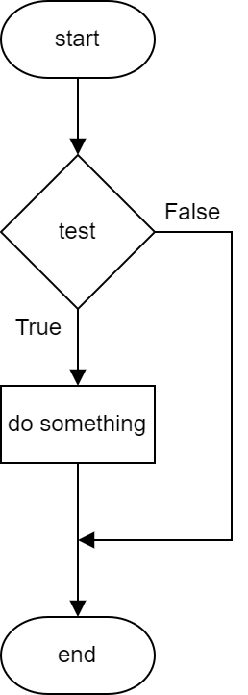
Flowchart – If
1 age = 0
2
3 age = int(input("Age? "))
4
5 if age >= 18:
6 print("Go in")

Slide 316
Flowchart – If
1 age = 0
2
3 age = int(input("Age? "))
4
5 if age >= 18:
6 print("Go in")

Slide 317
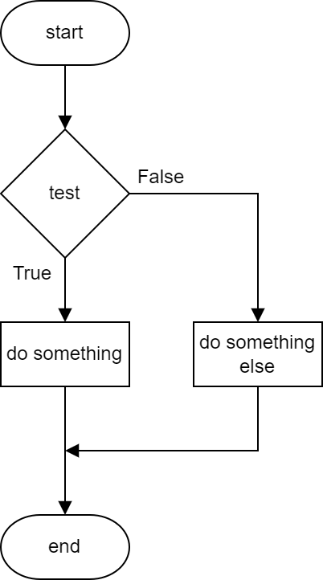
Flowchart – Else
1 age = 0
2
3 age = int(input("Age? "))
4
5 if age >= 18:
6 print("Go in")
7 else:
8 print("Get out!")

Slide 318
Flowchart – Else
1 age = 0
2
3 age = int(input("Age? "))
4
5 if age >= 18:
6 print("Go in")
7 else:
8 print("Get out!")

Slide 319
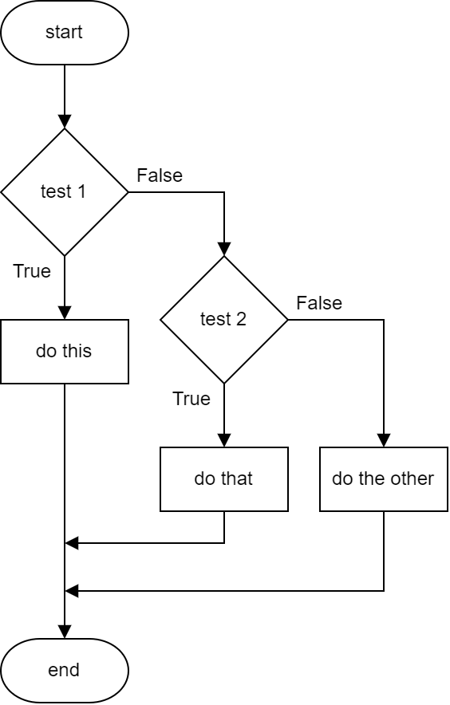
Flowchart – Else If
1 mark = 0
2 mark = int(input("Mark? "))
3 if mark >= 85:
4 print("Distinction")
5 elif mark >= 50:
6 print("Pass")
7 else:
8 print("Fail")

Slide 320
Flowchart – Else If
1 mark = 0
2 mark = int(input("Mark? "))
3 if mark >= 85:
4 print("Distinction")
5 elif mark >= 50:
6 print("Pass")
7 else:
8 print("Fail")

Slide 321
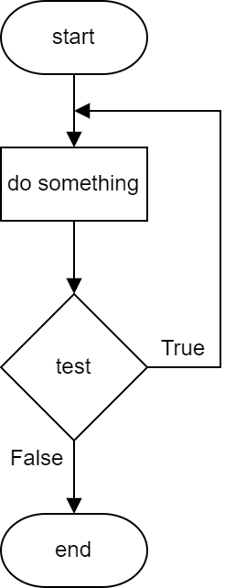
Flowchart – While (Repeat … Until)
1 cost, total, more = 0, 0, ""
2
3 while more != "n":
4 cost = int(input("Cost? "))
5 total = total + cost
6 more = input("More? (y/n)")
7
8 print("Total: " + str(total))

Slide 322
Flowchart – While (Repeat … Until)
1 cost, total, more = 0, 0, ""
2
3 while more != "n":
4 cost = int(input("Cost? "))
5 total = total + cost
6 more = input("More? (y/n)")
7
8 print("Total: " + str(total))

Slide 323
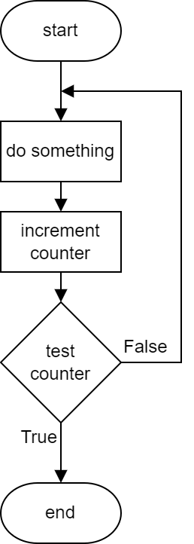
Flowchart – For
1 cost, total = 0, 0
2
3 for counter in range(4):
4 cost = int(input("Cost? "))
5 total = total + cost
6
7 print("Total: " + str(total))

Slide 324
Flowchart – For
1 cost, total = 0, 0
2
3 for counter in range(4):
4 cost = int(input("Cost? "))
5 total = total + cost
6
7 print("Total: " + str(total))

Slide 325
Learning Intentions
Describe, identify, and be able to read and understand:
  structure diagrams
  flowcharts
  pseudocode
Exemplify and implement one of the above design techniques to design efficient solutions to a problem.

Slide 326
Pseudocode
Written in structured English
Main steps show algorithm
Refinements show detail
SQA Reference Language (SQARL) != Pseudocode

Slide 327
Pseudocode
Written in
Main steps
Refinements
SQA Reference Language (SQARL)

Slide 328
Pseudocode – Example
1 Ask user to enter rectangle dimensions
2 Calculate perimeter
3 Calculate area
4 Display results
1.1 Ask user for length
1.2 Ask user for breadth
3.1 Calculate area: length x breadth
Algorithm
Refinements
Not all refinements shown
Notes:
Calculate perimeter and area of a rectangle

Slide 329
Pseudocode – Example
1 Ask user to enter rectangle dimensions
2 Calculate perimeter
3 Calculate area
4 Display results
1.1 Ask user for length
1.2 Ask user for breadth
3.1 Calculate area: length x breadth

Slide 330
Learning Intentions
Describe, exemplify, and implement user-interface design, in terms of input and output, using a wireframe.
Notes:
S4 pupils, not S3

Slide 331
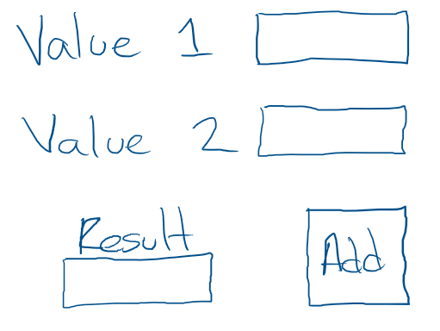
UI Wireframe
Used to show the inputs and outputs
Initially just a sketch
Inputs
Output
Submit
(to processes)
Notes:
Calculate perimeter and area of a rectangle

Slide 332
UI Wireframe
Used to show
Initially just
Notes:
Add two values together

Slide 333
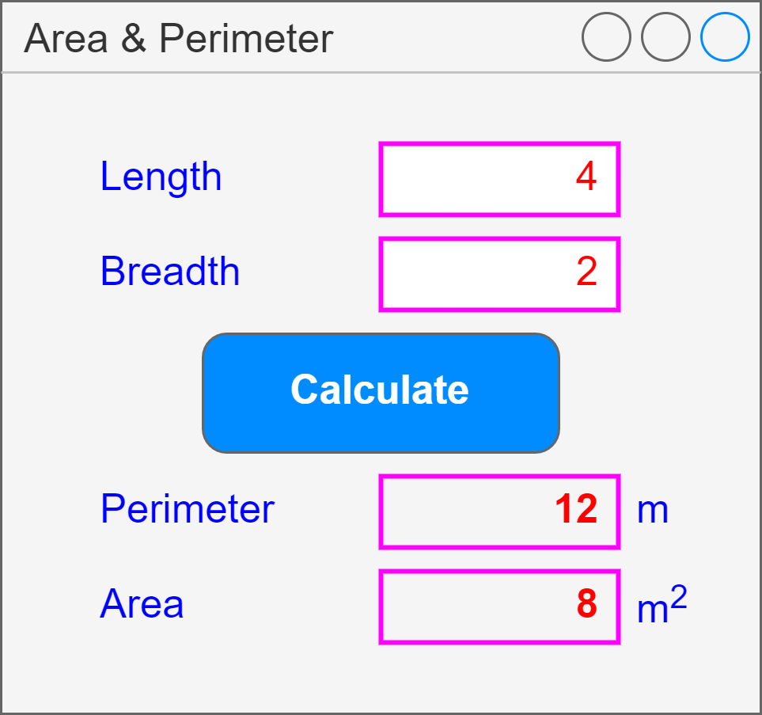
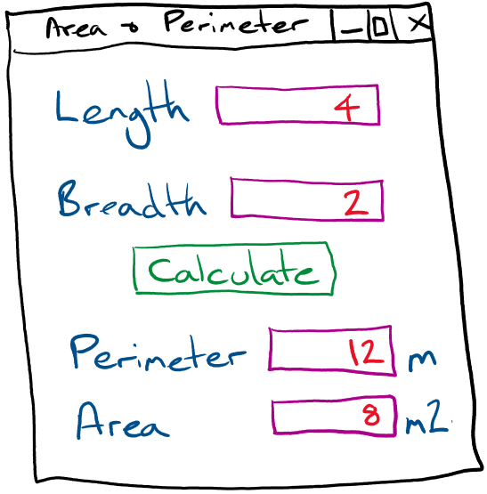
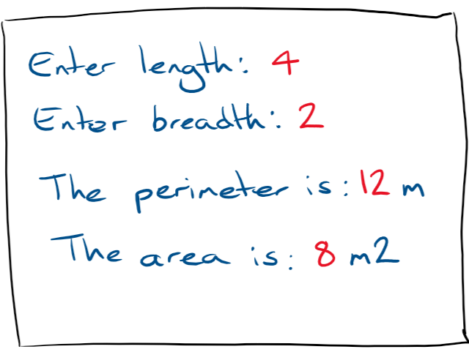
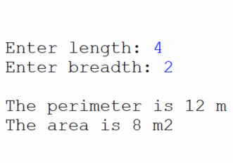
UI Wireframe – Example
App Based
Text Based
Text box
(input)
Inputs
Button
Submit
(process)
Text box
(output)
Outputs
Label
Notes:
Calculate perimeter and area of a rectangle
Use draw.io for app based version

Slide 334
UI Wireframe – Example

Slide 335
Calculator Wireframe
Create a wireframe for a simple calculator app that will only add, subtract, multiply and divide two numbers.

Slide 336
Evaluation

Slide 337
Learning Intentions
Describe, identify, and exemplify the evaluation of a solution in terms of:
  fitness for purpose
  efficient use of coding constructs
  robustness
  readability:
    internal commentary
    meaningful identifiers
    indentation
    white space

Slide 338
Fitness for Purpose
Comparison of solution (code and testing) with program analysis, not the design, and expected output
Does it do the requirements identified during analysis?
Assignment: Own code. Justify it!

Slide 339
Fitness for Purpose
Comparison of solution (code and testing) with program
Does it do the requirements

Slide 340
Efficiency
Describe efficiencies or inefficiencies such as
  Array vs multiple variables
  Nested ifs (else ifs) vs individual ifs
  Use of a loop vs lines of repeated code
Assignment: Own code. Justify it!

Slide 341
Efficiency
Describe
  Array
  Nested ifs (else ifs)
  Use of a loop

Slide 342
Robustness
Input validation (exceptional tests), or lack of it
Potential for errors – possible to enter incorrect values?
How it responds to unexpected data: text instead of number
Assignment: Own code. Justify it!

Slide 343
Robustness
Input validation (exceptional tests)
Potential for errors
How it responds to unexpected data

Slide 344
Internal Commentary
Explains what the code does
Helps clarify complex code
Helps others / future self
Assignment: Own code. Justify it!

Slide 345
Internal Commentary
Explains what
Helps clarify
Helps others

Slide 346
Meaningful Identifiers
Names relate to the data
Names indicate what they do / hold
Assignment: Own code. Justify it!

Slide 347
Meaningful Identifiers
Names
Names indicate what

Slide 348
Indentation
Highlights structures
Assignment: Own code. Justify it!

Slide 349
Indentation

Slide 350
White Space (Blank lines)
Between structures in program
Easier to see sections of code
Assignment: Own code. Justify it!

Slide 351
White Space
Between
Easier to

Slide 352
Learning Intentions
Describe and use internal commentary

Slide 353
Special Comments
  59 # TODO: Display result
  74 # BUG: Not calculating correctly
Codetag: Something to be done
Codetag: A problem to be sorted
Reminders of what needs to be done
Notes:
Excellence creep! Works in Thonny.
PEP 350 - https://peps.python.org/pep-0350/

Slide 354
Special Comments
  59 # TODO: Display result
  74 # BUG: Not calculating correctly

Slide 355
Learning Intentions
Describe and use array concatenation

Slide 356
Concatenate – Strings – Revision
1 text = ""
2
3 for counter in range(5):
4 text = text + str(counter)
5
6 print(text)
Empty string
Concatenate
Cast to string
Notes:
Super size: ask how many times to loop (limit 2-5), ask for character to concatenate

Slide 357
Concatenate – Strings – Revision
1 text = ""
2
3 for counter in range(5):
4 text = text + str(counter)
5
6 print(text)

Slide 358
Concatenate – Arrays
1 values = []
2
3 for counter in range(5):
4 values = values + [counter]
5
6 print(values)
Empty array
Concatenate
Cast to array
Notes:
Super size: ask how many times to loop (limit 1-6), ask for dice value (1-6)
Super-super size: display average of dice values

Slide 359
Concatenate – Arrays
1 values = []
2
3 for counter in range(5):
4 values = values + [counter]
5
6 print(values)

Slide 360
Learning Intentions
Describe and use a standard algorithm for traversing a 1-D array

Slide 361
Traversing an array – For Each
1 ages = [11, 14, 13, 14, 12]
2
3 for age in ages:
4 print(age)
Loops for each element in array
Known as a For Each loop

Slide 362
Traversing an array – For Each
1 ages = [11, 14, 13, 14, 12]
2
3 for age in ages:
4 print(age)
Loops for
Known as

Slide 363
Learning Intentions
Describe and use fixed loops

Slide 364
Sequences
Start value
range(1, 5)
1, 2, 3, 4
range( ) function
Stop value
range(5)
0, 1, 2, 3, 4
All values
integers
Stop value (always starts at 0)
range(1, 7, 2)
1, 3, 5
Step value
Notes:
If a start value isn’t specified, then it’s 0 (zero).
Info only: list(range(1, 10)) → [1, 2, 3, 4, 5, 6, 7, 8, 9]

Slide 365
Sequences
range(1, 5)
1, 2, 3, 4
range(5)
0, 1, 2, 3, 4
range(1, 7, 2)

Slide 366
Fixed Loop – Step Example
Loop variable
Step
1 for value in range(1, 10, 2):
2
3 print(value)
Start and Stop values required if Step used

Slide 367
Fixed Loop – Step Example
1 for value in range(1, 10, 2):
2
3 print(value)

Slide 368
Learning Intentions
Describe and use a standard algorithm for input validation
Notes:
Used to limit input values to acceptable values

Slide 369
Input Validation – Input in Loop - Overview
1 Initialise variable used in condition
2 Repeat until condition is FALSE
3 Get user input
4 Check user input
5 Display error message, if needed

Slide 370
Input Validation – Input in Loop - Overview
1 Initialise variable used in condition
2 until condition
3 Get
4 Check
5 Display error

Slide 371
Input Validation – Input in Loop
Not an acceptable value
Must be True to begin
1 pax = 0
2 while pax < 1:
3
4 pax = int(input("Passengers: "))
5
6 if pax < 1:
7 print("Must be at least 1.")
User input
Error message: meaningful
Conditional loop always used
Notes:
Simple condition. Error message to be meaningful, i.e. better than "Invalid"
Number of taxi passengers

Slide 372
Input Validation – Input in Loop
1 pax = 0
2 while pax < 1:
3
4 pax = int(input("Passengers: "))
5
6 if pax < 1:
7 print("Must be at least 1.")

Slide 373
Input Validation – Complex Condition
Not an acceptable value
Must be True to begin
1 pax = 0
2 while pax < 1 or pax > 5:
3
4 pax = int(input("Passengers: "))
5
6 if pax < 1 or pax > 5:
7 print("Must be 1 to 5.")
User input
Error message
Notes:
Complex condition. Error message to be meaningful, i.e. better than "Invalid"

Slide 374
Input Validation – Complex Condition
1 pax = 0
2 while pax < 1 or pax > 5:
3
4 pax = int(input("Passengers: "))
5
6 if pax < 1 or pax > 5:
7 print("Must be 1 to 5.")

Slide 375
Input Validation – Simple String
Not an acceptable value
1 fact = ""
2 while fact != "Computing":
3
4 fact = input("Best subject? ")
5
6 if fact != "Computing":
7 print("Computing is the best!")
Must be True to begin
User input
Error message

Slide 376
Input Validation – Simple String
1 fact = ""
2 while fact != "Computing":
3
4 fact = input("Best subject? ")
5
6 if fact != "Computing":
7 print("Computing is the best!")

Slide 377
Task – Add Input Validation
Add input validation to the following Replit tasks:
  N5 SDD Ask Questions – Loops: Min 1
  N5 SDD School Days Left – Days: Min 0, Max 190
  N5 SDD - Decisions Decisions – Voucher: "yes" or "no"
Notes:
Input validation
Efficient selection

Slide 378
Task – University Degree Classifications
Degrees are given classifications:
  First 70-100
  2-1 60-69
  2-2 50-59
  Third 40-49
  Fail 0-39
Assumptions
All values integers
Create a test table first!
Notes:
Input validation
Efficient selection

Slide 379
Learning Intentions
Describe and use a standard algorithm for a running total within a loop

Slide 380
Running Total - Fixed Loop
1 value = 0
2 total = 0
3
4 for counter in range(4):
5
6 value = int(input("Value? "))
7 total = total + value
Notes:
Revision

Slide 381
Running Total - Conditional Loop
Not an acceptable value
1 answer = ""
2 value, total = 0, 0
3
4 while answer != "no":
5 value = int(input("Value? "))
6 total = total + value
7
8 answer = input("Another value? ")
Python shorthand (Don't use!)
Notes:
Loops until condition is false

Slide 382
Running Total - Conditional Loop
1 answer = ""
2 value, total = 0, 0
3
4 while answer != "no":
5 value = int(input("Value? "))
6 total = total + value
7
8 answer = input("Another value? ")

